Slide 1
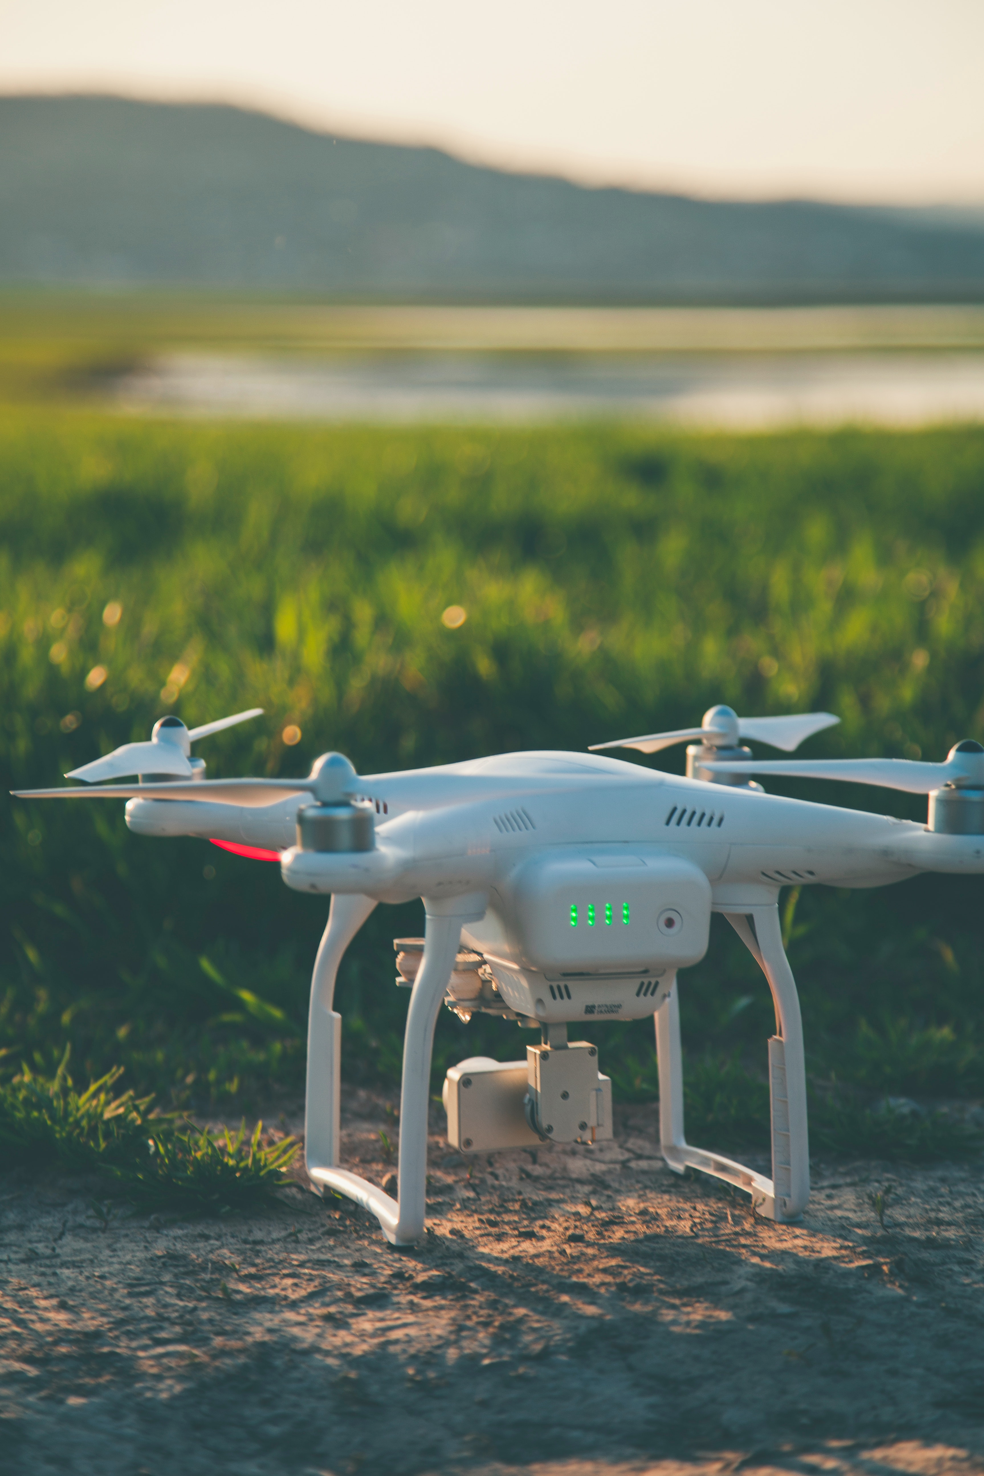
Soil analysis using Machine Learning
Mahmood Yousaf
2018-UET-NML-CS-11
Supervisor: Dr Malik Jahan

Slide 2
Today Plan
Problem statement
Solution
Methodology
Questions

Slide 3




Problem Statement
Time consuming
More Cost
Soil sample
Laboratory Testing

Slide 4




Solution
Deployed model on aws
Drone flight to capture data
Provide Report
Hyperspectral sensor
Fertilizers
Android Application

Slide 5
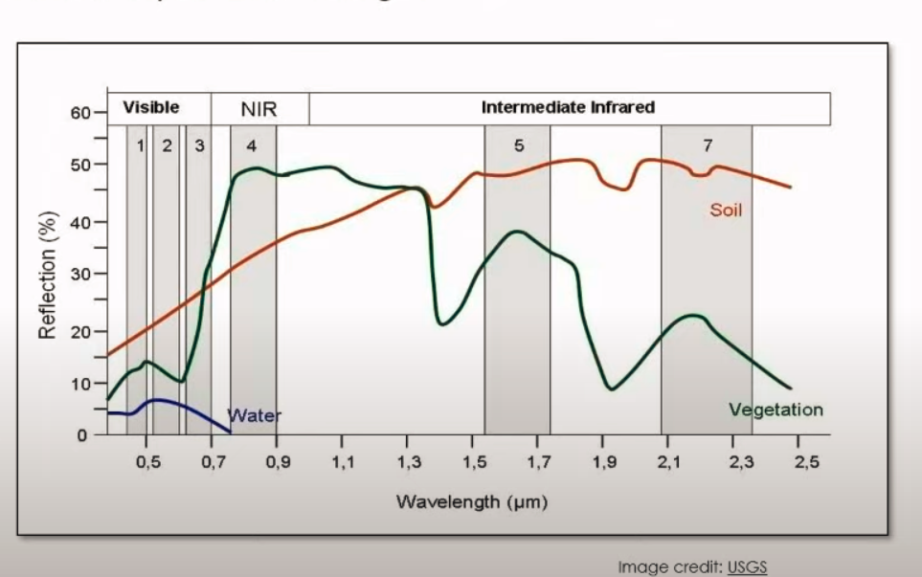
Why Hyperspectral sensor?
Hyperspectral imaging, like other spectral imaging, collects and processes information from across the electromagnetic spectrum. The goal of hyperspectral imaging is to obtain the spectrum for each pixel in the image of a scene, with the purpose of finding objects, identifying materials, or detecting processes
RGB vs Hyperspectral sensor

Slide 6


Slide 7
Methodology
Data Gather
Pre-Processing
Literature review for feature extraction
Selecting machine learning models according to features
Training and testing
Evaluation of different models
Exhaustive comparison of different machine learning models

Slide 8
Questions ☺

Slide 9
References
White and Gray Quadcopter on Ground · Free Stock Photo (pexels.com)
selective focus photography of DJI Phantom 3 Professional quadcopter drone photo – Free Drone Image on Unsplash
green trees on brown field during daytime photo – Free Bielawa Image on Unsplash
black Sony Xperia android smartphone photo – Free Android Image on Unsplash
Hyperspectral Imaging Analysis for the Classification of Soil Types and the Determination of Soil Total Nitrogen (nih.gov)
EarthExplorer (usgs.gov)

